Slide 1
Introduction to Atomistic Hamiltonians
Yuan Ping
Last Update: 9/9/24

Slide 2
Introduction to Atomistic Hamiltonians
Classical vs. Quantum Modeling and Hamiltonians
Solving vs. Simulating
Accuracy vs. speed

Slide 3
Two Classes of Atomic Scale Methods
Quantum mechanical modeling
Solves the Schrodinger equation for the electrons to get electronic structure
Also gives total energies
Slow because solving quantum equations for all the electrons is hard
Potential modeling (“Classical”, “Molecular Modeling”, “Semi-empirical potentials”)
No electrons so no electronic structure
Gives energies
Faster (compared to QM) because electrons are not treated explicitly

Slide 4
Atomistic Modeling Framework
Hamiltonian H
(Basic physics of system)
Solve + Simulate
(Derive static, dynamic, thermodynamic properties from H)
Analyze
(Derive macro properties from calculations)

Slide 5
Hamiltonians
Atomistic modeling efforts generally start with a Hamiltonian (H) that is a function of the relevant degrees of freedom, usually atom positions/momenta ({r},{p}) and sometimes electron positions/momenta ({R},{P}).
H determines the basic physics of the system (static equilibrium, time dynamics, thermodynamics), and essentially all phenomena of interest can be derived from H.
The challenge of atomistic modeling is to make H accurate and fast.

Slide 6
Two Classes of Atomic Scale Hamiltonians
Quantum mechanical modeling
Solves the Schrodinger equation for the electrons to get electronic structure
Also gives total energies
Slow because solving quantum equations for all the electrons is hard (typical/max 10²/10³ atoms, time ~ 10¹-10³ ps)
Density functional theory is a quantum mechanical method
Potential modeling (“Classical”, “Molecular Modeling”, “Semi-empirical potentials”)
No electrons so no electronic structure
Gives energies
Faster because electrons are not treated explicitly (typical/max 10⁴/10⁹ atoms, time~ 10³-10⁵ ps)

Slide 7
Hamiltonian Examples: Ideal Gas
For identical noninteracting particles
Statistical Mechanics
Thermodynamics
Allows analysis of behavior of ideal gasses

Slide 8
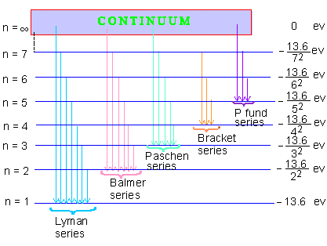
Hamiltonian Examples: Hydrogen Atom
For the electron in a hydrogen atom
Solve eigenvalue equation
For electron energy levels
Optical spectrum of Hydrogen
http://www.pinkmonkey.com/studyguides/subjects/physics/chap32/img3217.gif

Slide 9
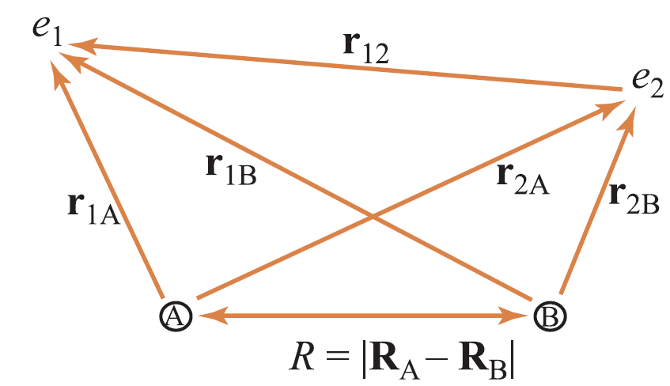

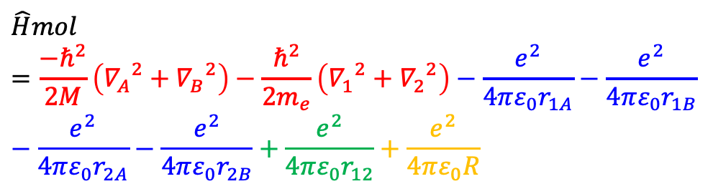

Example of H₂ Molecule
H = T (kinetic)+ V (potential)
T
$$\hat{H}mol =\frac{−ℏ^{2}}{2M}\left({∇_{A}}^{2}+{∇_{B}}^{2}\right)−\frac{ℏ^{2}}{2m_{e}}\left({∇_{1}}^{2}+{∇_{2}}^{2}\right)−\frac{e^{2}}{4πε_{0}r_{1A}}−\frac{e^{2}}{4πε_{0}r_{1B}}−\frac{e^{2}}{4πε_{0}r_{2A}}−\frac{e^{2}}{4πε_{0}r_{2B}}+\frac{e^{2}}{4πε_{0}r_{12}}+\frac{e^{2}}{4πε_{0}R}$$
M
H₂ molecule
Nucleus are so much more massive than the electrons → view the nuclei as fixed in position relative to the motion of electrons
”Born-Oppenheimer” approx.
$${\hat{H}}_{mol}ψ_{mol}\left(r_{1},r_{2},R_{A},R_{B}\right)=E_{mol}ψ_{mol}$$
$$ψ_{mol}\left(r_{1},r_{2},R_{A},R_{B}\right)=ψ_{el}\left(r_{1},r_{2},R\right) ψ_{nucl.}(R_{A},R_{B})$$
$${\hat{H}}_{el}ψ_{el}\left(r_{1},r_{2},R\right)=E_{el}(R)ψ_{el}(r_{1},r_{2},R)$$
$E_{el}(R)$: electronic energy at R
${\hat{H}}_{el}$:
doesn’t contain nuclei kinetic and potential energy terms

Slide 10
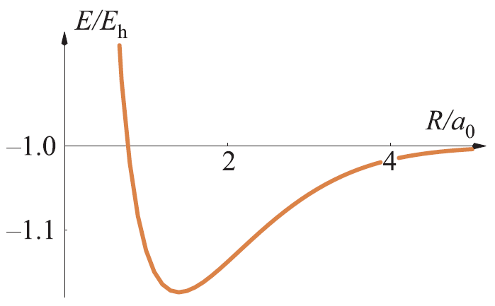
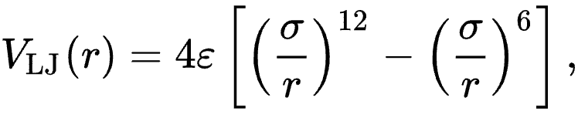
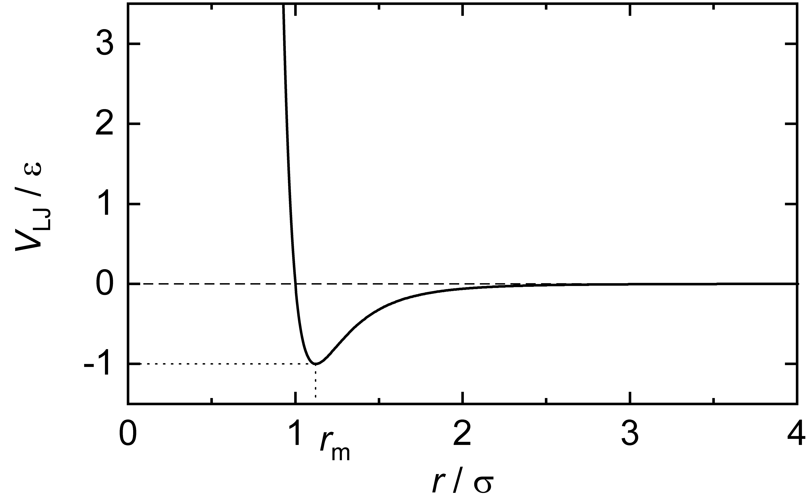
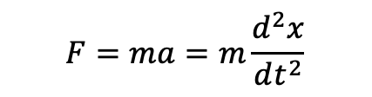
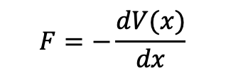

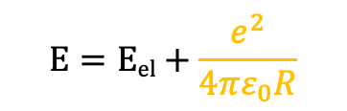
Potential Energy Surface of H₂ Molecule
$$R_{e}$$
$$E=Eel+\frac{e^{2}}{4πε_{0}R}$$
Potential energy from Quantum mechanics
Classical potential (Lennard-Jones potential 6-12) for interparticle interactions Physica, 27, 6, June 1961, Pages 523 (H2)
Then compute forces F from potentials V(x):
$$F=−\frac{dV(x)}{dx}$$
$$F=ma=m\frac{d^{2}x}{dt^{2}}$$
Molecular dynamics

Slide 11
Solving and Simulating (1)
The physical implications of the Hamiltonian require work to extract
Quantum mechanics: Solve Schrödinger equation for electronic eigenstates
Classical potential: Solve for energy of complex atomic arrangement
Statics: Time independent (t=0), zero temperature (T=0) properties [t,T=0]. Relax system to equilibrium, look at perturbations
Dynamics: Evolve system forward in time (Molecular dynamics, (kinetic) Monte Carlo)
Thermodynamics: Find thermal averages and thermodynamic potentials by exploring many states (Molecular dynamics, Monte Carlo)

Slide 12
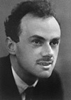
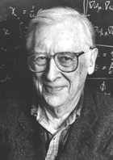
Solving and Simulating (2)
“The fundamental laws necessary for the mathematical treatment of a large part of physics and the whole of chemistry are thus completely known, and the difficultly lies only in the fact that application of these laws leads to equations that are too complex to be solved”
P.A.M. Dirac, 1929 (J.A. Pople, Nobel Lecture, 1998)
Solving/Simulating is a major challenge!
Tradeoff between accuracy and speed

Slide 13
Accuracy vs. Speed
Quantum Methods
E.g., Quantum Monte Carlo, Hartree-Fock,
Density functional theory, Tight-binding
Explicit quantum mechanics/electrons
~10² atoms, ~10⁻¹¹ sec
BEST
Accuracy
Potential Methods
E.g., Lennard-Jones, Embedded Atom,
Stillinger-Weber, CHARM
No explicit quantum mechanics/electrons
~10⁸ atoms, ~10⁻⁷ sec
Speed

Slide 14
Summary
Hamiltonians control the energetics of the system and can be classical or quantum
Atomistic modeling generally has 3 steps: identify the Hamiltonian, solve/simulate it, analyze the results.
The limitations on atomistic modeling are the speed (length/time scales) and accuracy with which problems can be solved. State of the art methods can regularly treat (typical/max 10²/10³ atoms, time ~ 10¹-10³ ps) (quantum) or (typical/max 10⁴/10⁹ atoms, time~ 10³-10⁵ ps) (potentials).

Slide 15
END

